Slide 1
What is 3D Slicer?
Nobuhiko Hata, PhD

Slide 2
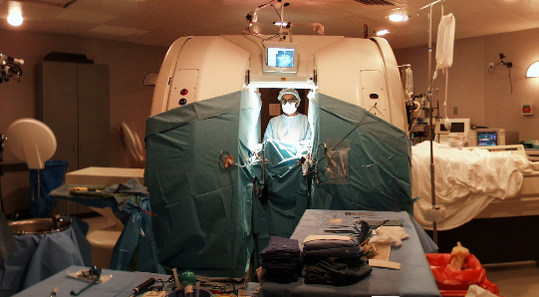
The first MR-guided therapies 1994-

Slide 3
1993-: LYMB -> VTK (Schroeder, Will; Martin, Ken; Lorensen, Bill) 1993-
1995: VTK 0.5 delivered to Kikinis/Hata
1997” PJ Kelly’s comment to Hat 1997 paper in Neurosurgey
Fast Slicing – Hata/Westin
IJK-to-RAS concept – Hata
RAS-to-RAS for registration - Hata
MICCAI 99 (Cambridge)
MRML – Wells/Gering/Kikinis

Slide 4
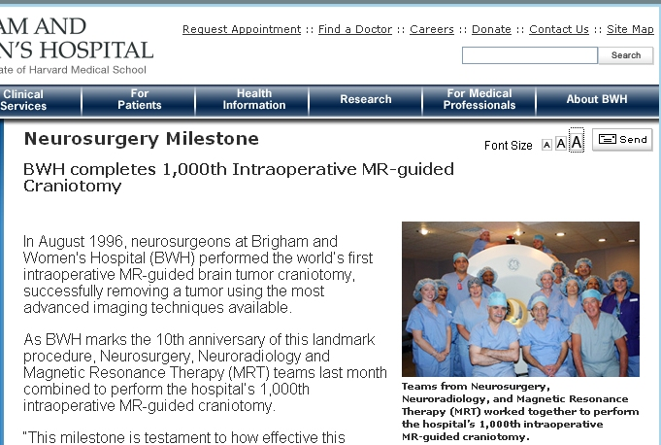
1996-2006 – 1000+ Neurosurgey case

Slide 5
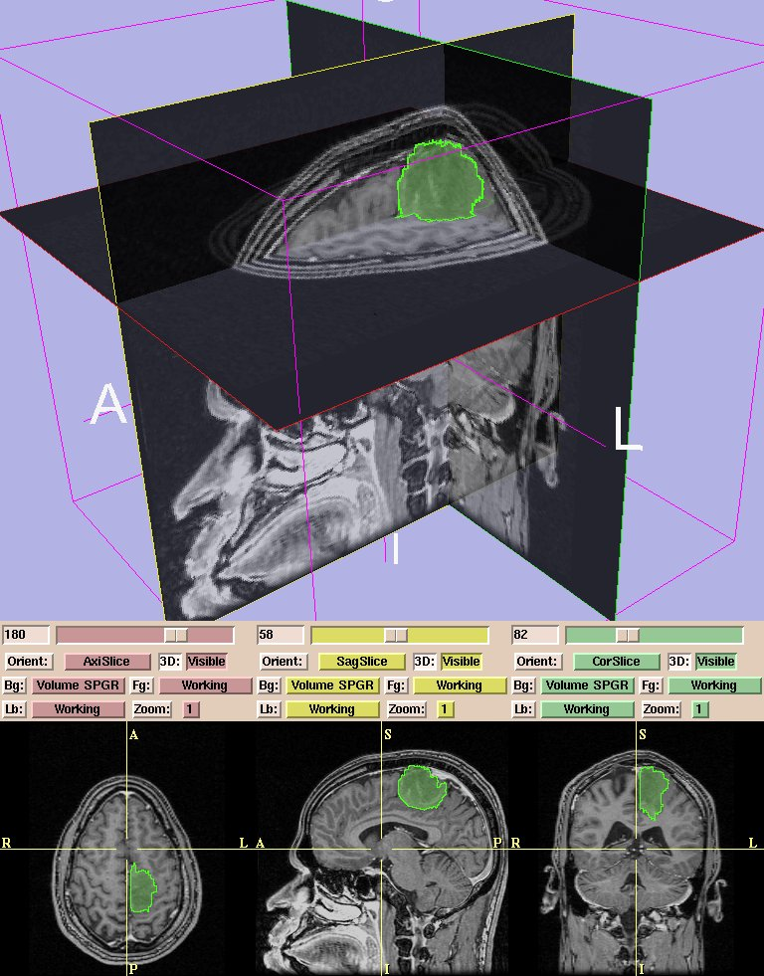

Slide 6
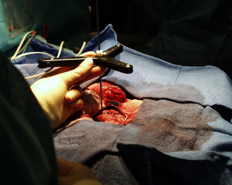
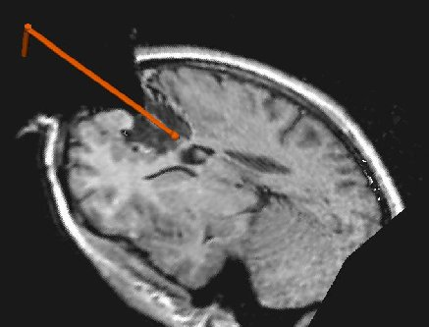
3D Tracker
Provided by D. Gering

Slide 7

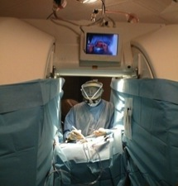
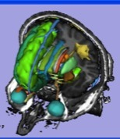
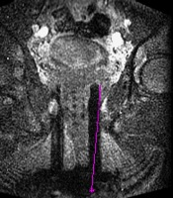
Image Guided Therapy at BWH
Biomedical science
Engineering science
3D SLICER
Image processing
Interventional devices
Robotics
MR engineering
MR Thermometry
MR physics
Real-Time MR
sequences
Registration
Segmentation
AMIGO
MRg neurosurgery
MRg percutaneous
Liver/Kidney
MRg FUS
MRg prostate
MRg gyn implants
Breast, Fibroids, Bone, Brain, Prostate

Slide 8
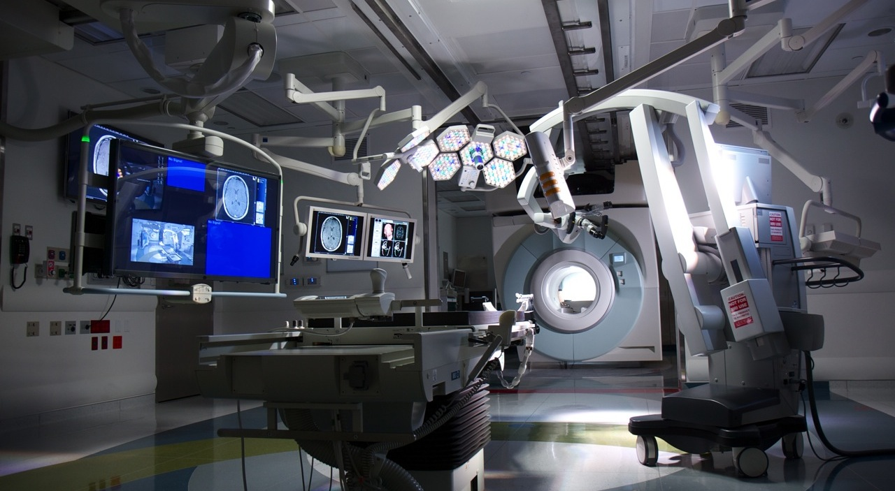
Multi-modal Imaging OR: AMIGO May 2011-

Slide 9
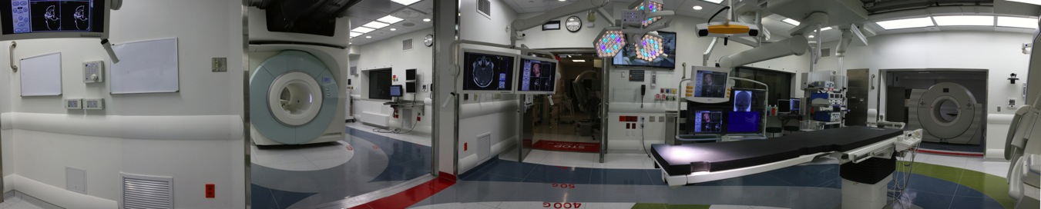
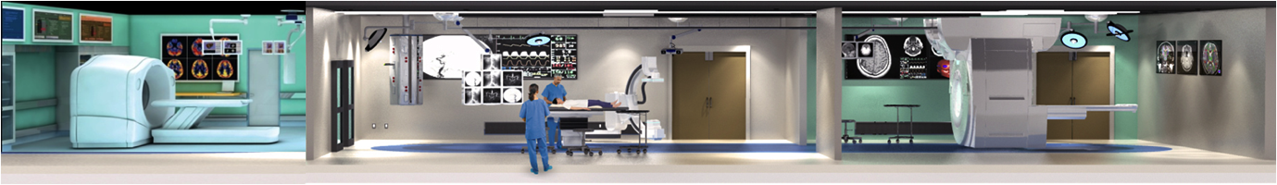
AMIGO

Slide 10
What is 3D Slicer?

Slide 11
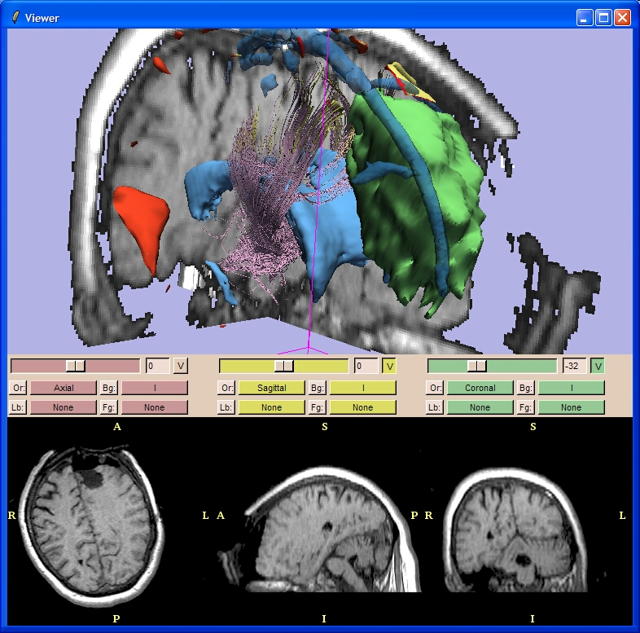
What is 3D Slicer?
3D Slicer is…
An end-user application for 3D medical image computing research and Image Guided Therapy
A platform for research where new techniques can be plugged into a useful framework
A freely-downloadable program with source and binaries for Windows, Linux, Solaris and (increasingly) Mac OSX
NOT an FDA approved medical device and CANNOT be used clinically without proper research controls (IRB etc.)
NOT finished – some parts will work better than others and it is constantly evolving
Slide courtesy of Drs. Kikinis and Pieper

Slide 12
What is 3D Slicer in IGT?

Slide 13
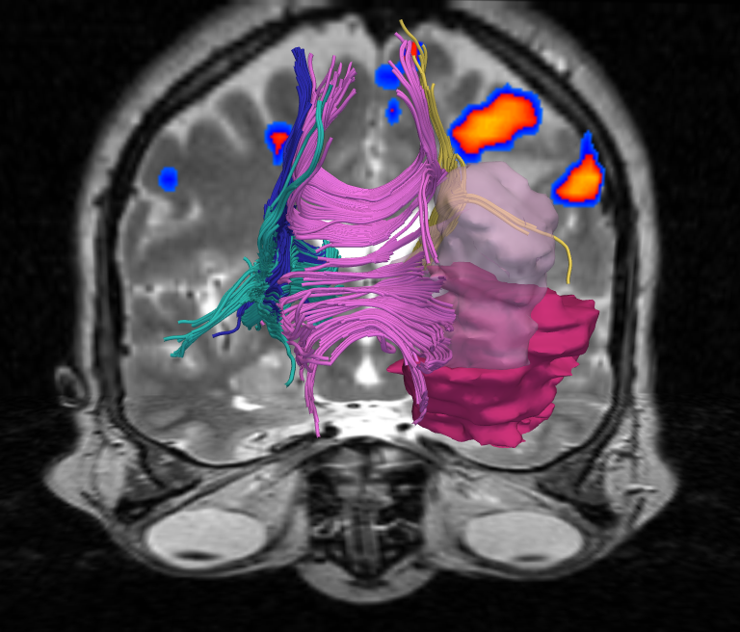
Slicer in IGT
3D Slicer can facilitate application of state-of-art medical image processing in IGT
AND
IGT specific extension to support this translation
Tracker (IGSTK, Cleary RO1)
MRI scanners
Endoscope support
(3D US)
DICOM on-line transfer

Slide 14
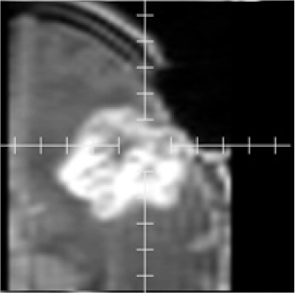
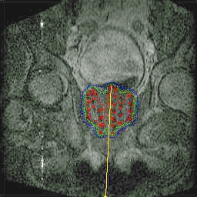
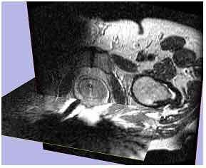
Software Design
To maximize function commonalities among applications
Brain (biopsy, craniotomy, NdYAG laser ablation)
Prostate (brachytherapy, biopsy)
Liver and kidney (Microwave, Cryo, laser ablation)
Endoscopy (broncho-, neuro-, feto-scopy)

Slide 15
Unique requirements in CAI
Device (tracker, robot, imaging)
Proprietary device, often with closed access to internal data
Open IGT Link (Tokuda et al . Later today).

Slide 16
What is Slicer for your collaborating physicians?

Slide 17
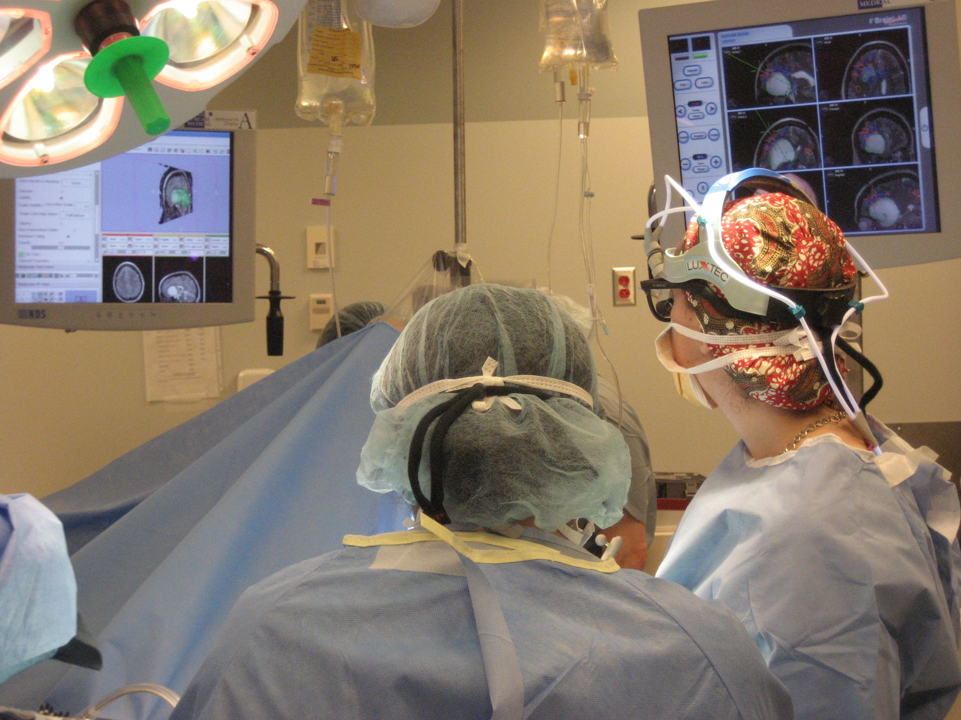

Slicer3

Slide 18
What is 3D Slicer in Industry-Academic Collaboration?

Slide 19
Partnership with Industry
Providing advanced medical image processing, visualization, navigation, robotics technology
Exploring new clinical methods in 3D Slicer
Transitioning to more sustainable clinical program, or dissemination by commercialization

Slide 20
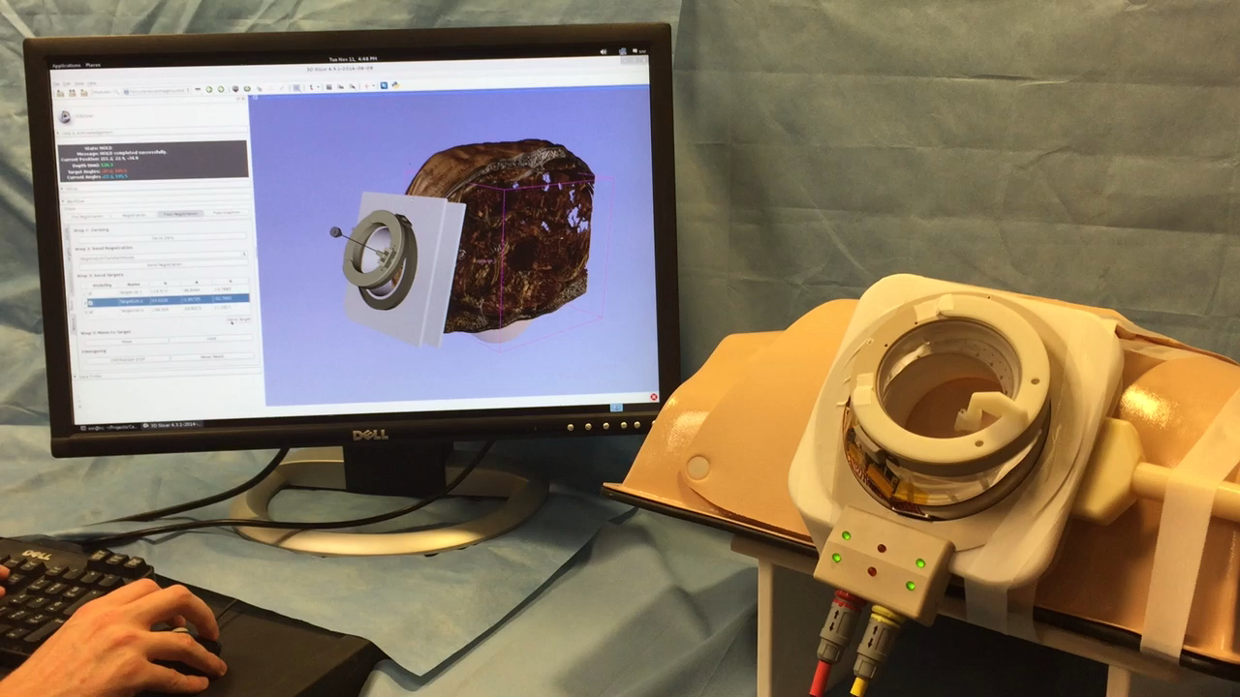

Slide 21
What is Slicer for your collaborators?

Slide 22
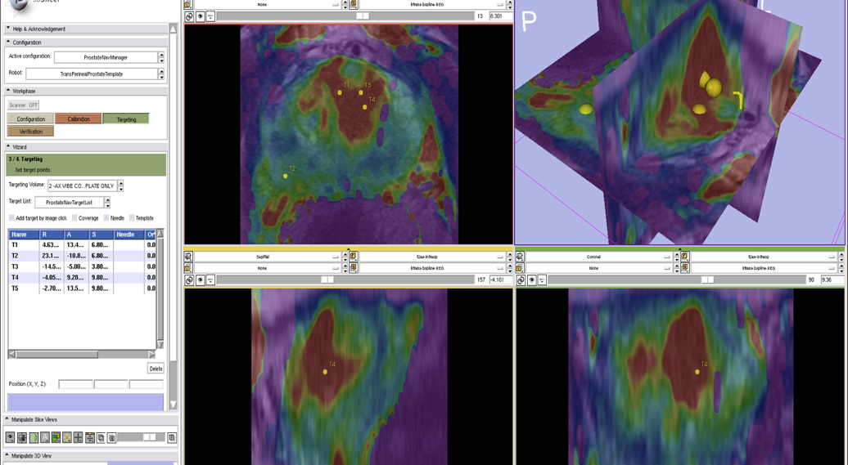
MRI-guided prostate biopsy at BWH
Tempany et al

Slide 23
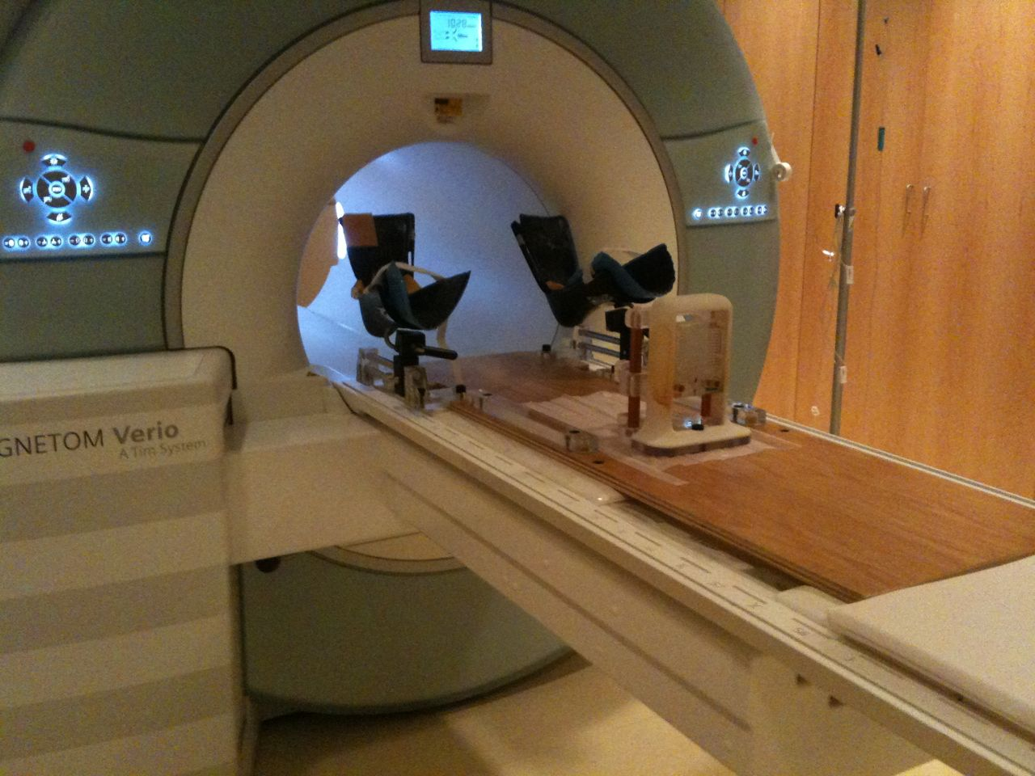
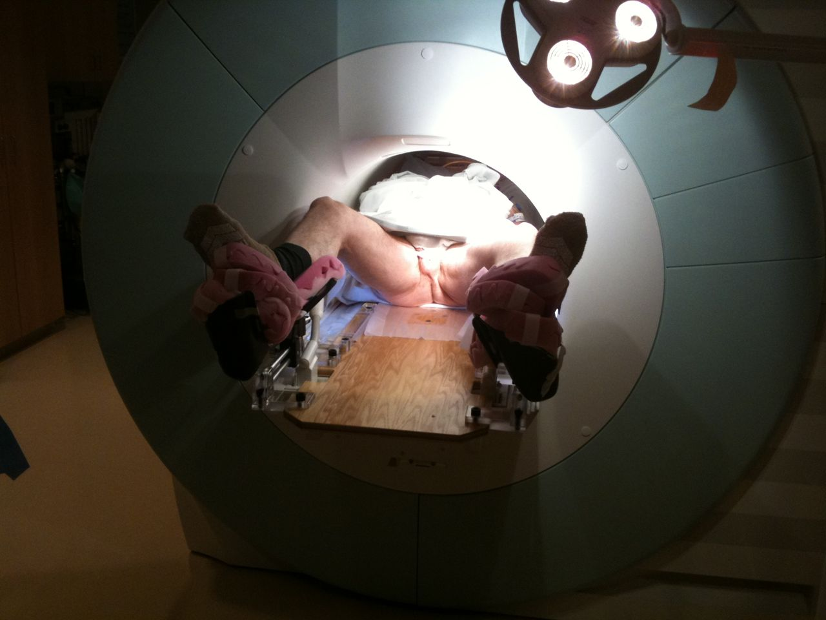
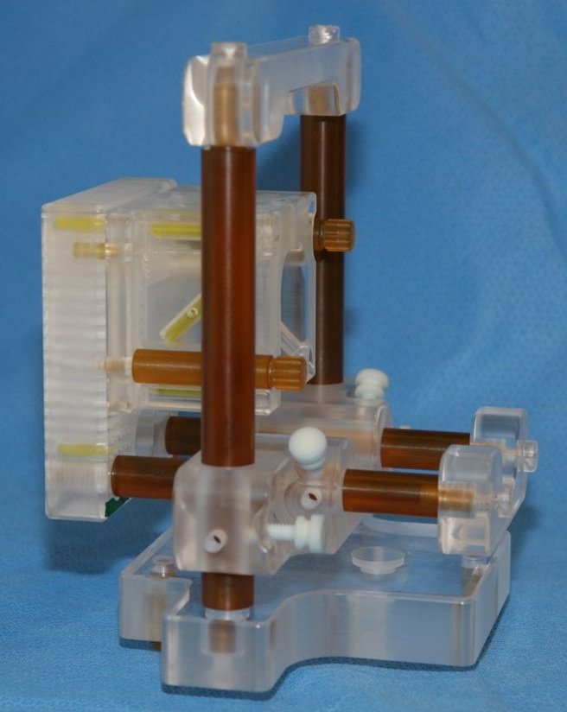
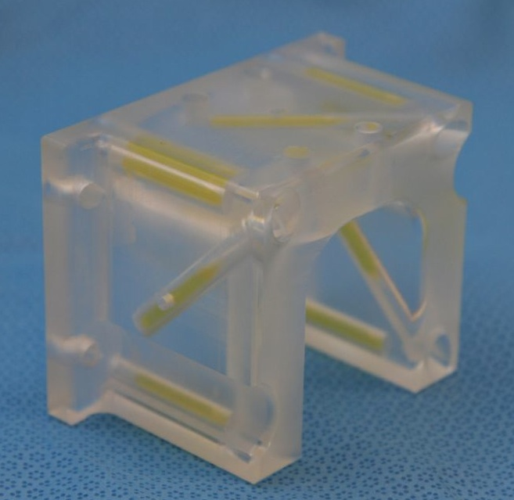
Prostate Intervention in BWH
(A) Base board
(B) Leg support
(C) Stationary frame
(D) Template (plexiglas)
(E) “Z-frame”
(D)
(E)
(B)
(B)
(C), (D)
(A)

Slide 24
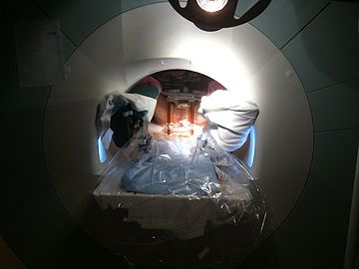
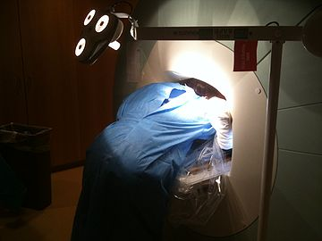
Tempany, Song, Tokuda, Kacher, Iordachita, Fairhurst, Kanan, Tuncali

Slide 25
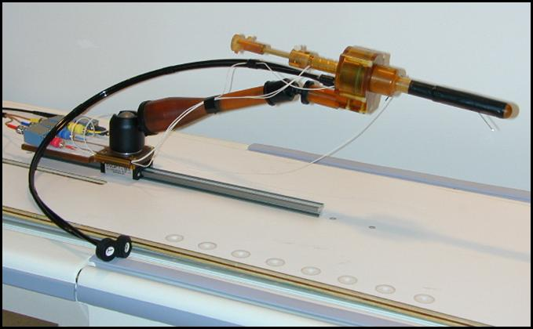
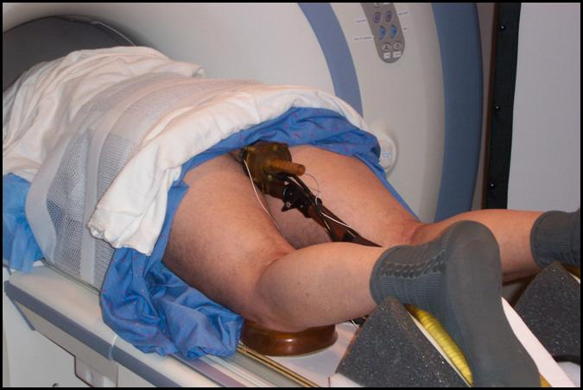
Trans-Rectal Robotic Prostate Biopsy (Fichtinger, Queens Univ)
Objective: Develop and integrate end-to-end application module inside 3D Slicer to perform robotic prostate biopsy intervention
[1] Krieger A, Susil RC, Menard C, Coleman JA, Fichtinger G, Atalar E, Whitcomb LL, Design of A Novel MRI Compatible Manipulator for Image Guided Prostate Intervention, IEEE Trans. Biomed. Eng. 2005; 52(2):306-313
[2] Susil RC, Ménard C, Krieger A, Coleman JA, Camphausen K, Choyke P, Ullman K, Smith S, Fichtinger G, Whitcomb LL, Coleman NC, Atalar E, Transrectal Prostate Biopsy and Fiducial Marker Placement in a Standard 1.5T MRI Scanner, J Urol. 2006 Jan;175(1):113-20
Fichtinger

Slide 26
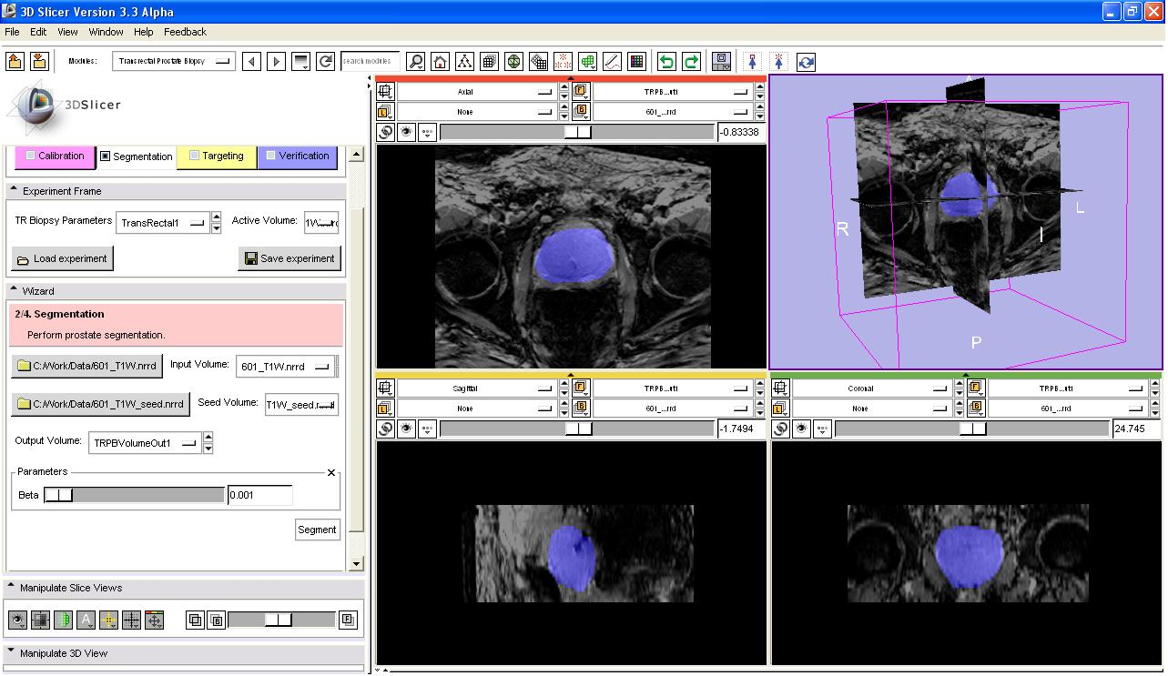
Segment
Fichtinger

Slide 27
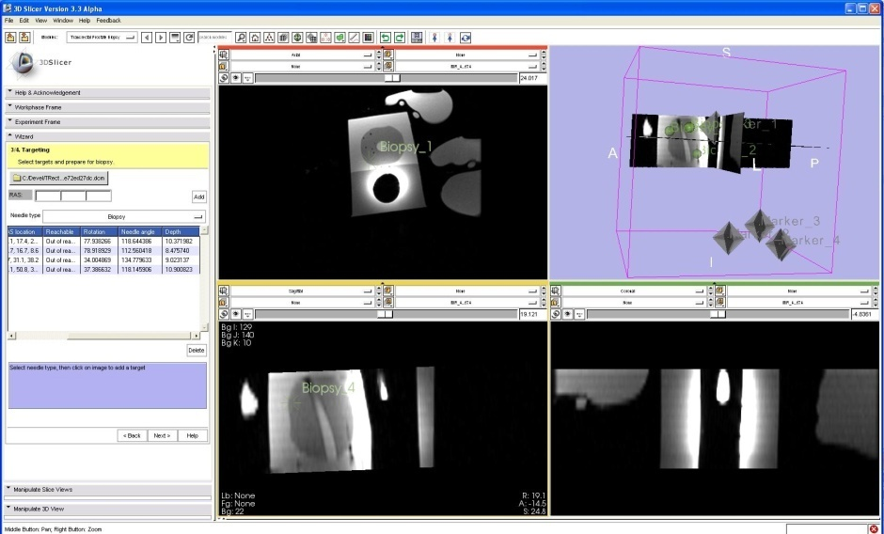
Target
Fichtinger

Slide 28
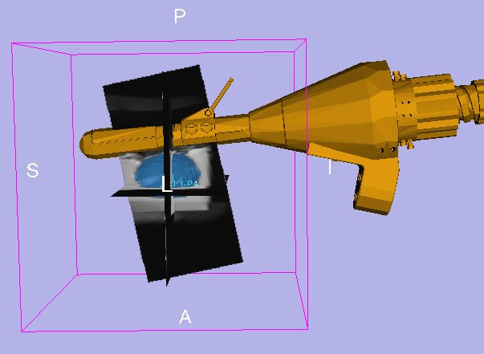
Navigate
Fichtinger

Slide 29
What is Slicer for you (student) and healthcare research (patient)?

Slide 30
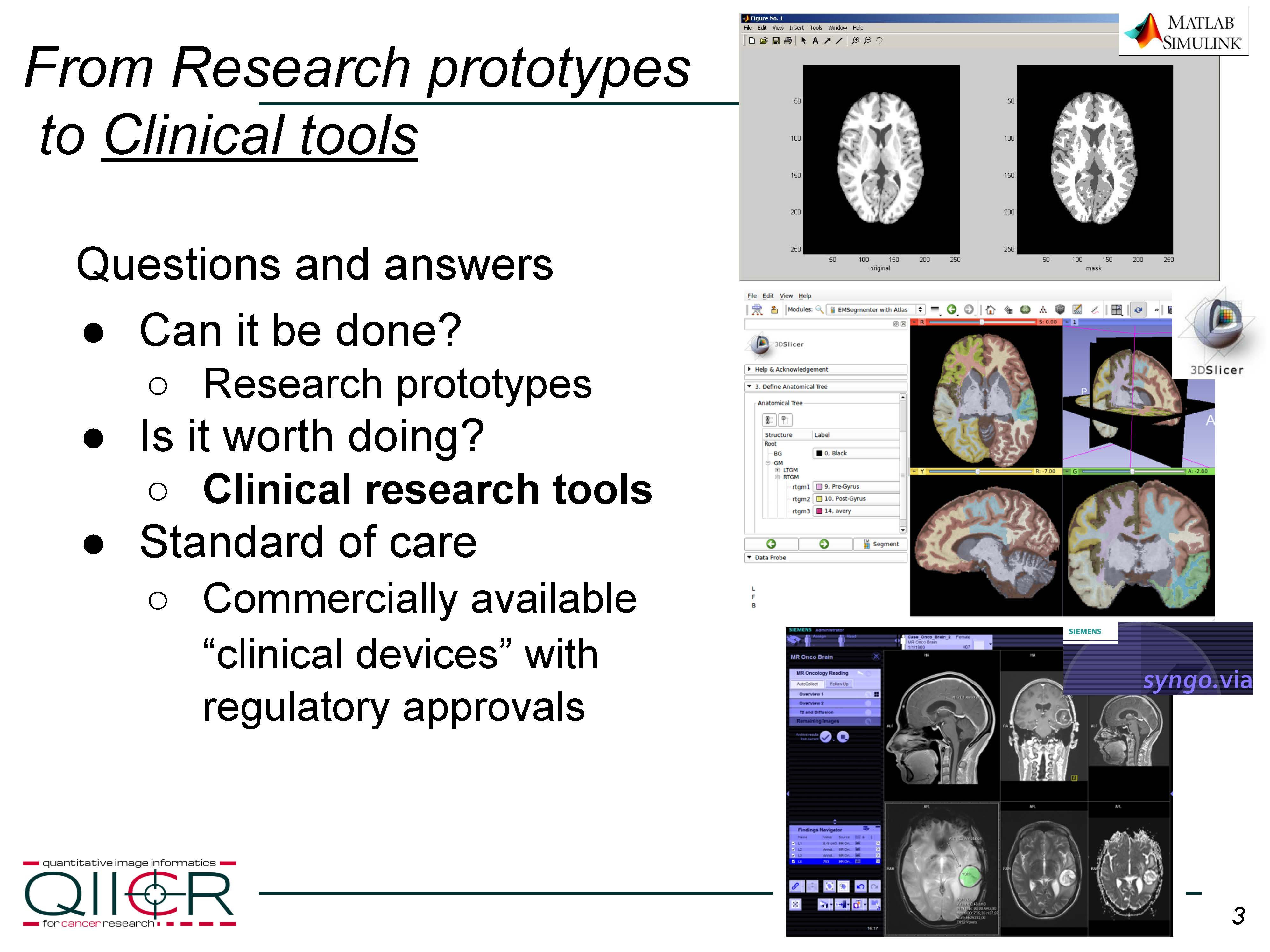
Slide courtesy of Fedorov, Kikinis

Slide 31
Slide courtesy of Fedorov, Kikinis

Slide 32
Slide courtesy of Fedorov, Kikinis

Slide 33
Standard of Care
Industry software
510K, PMA
Many (undisclosed) precedents of 3D Slicer used in commercial medical devices
Software for Medical Devices
Benefit/Challenges

Slide 34
Conclusion
Image Guided Therapy
Robot, as positioning tool, enhances the precision of the MRI-guided therapy
Added value - organ motion compensation will enable IGT of moving organ
National Center for Image Guided Therapy facilitates IGT research in both academic and industrial research programs
Notes:
39 MIN

